Slide 1
AI-Powered Plant Disease
Detection & Management
A CRISP-DM Data Mining Project
[Team Member Names]
MS Software Engineering - Data Mining
San Jose State University
December 2025

Slide 2






CRISP-DM Methodology: A Structured Approach
Our project followed the Cross-Industry Standard Process for Data Mining (CRISP-DM) to ensure a systematic and robust approach to problem-solving and model development.
Business Understanding
Data Understanding
Defining the agricultural problem and key performance indicators (KPIs).
Analyzing the PlantVillage dataset for insights and challenges.
Data Preparation
Modeling
Implementing a heavy augmentation strategy to enhance data quality.
Utilizing MobileNetV2 with transfer learning for efficient model training.
Evaluation
Deployment
Assessing model performance using accuracy, F1-score, and confusion matrices.
Integrating the solution with Gradio and a RAG chatbot for practical use.

Slide 3
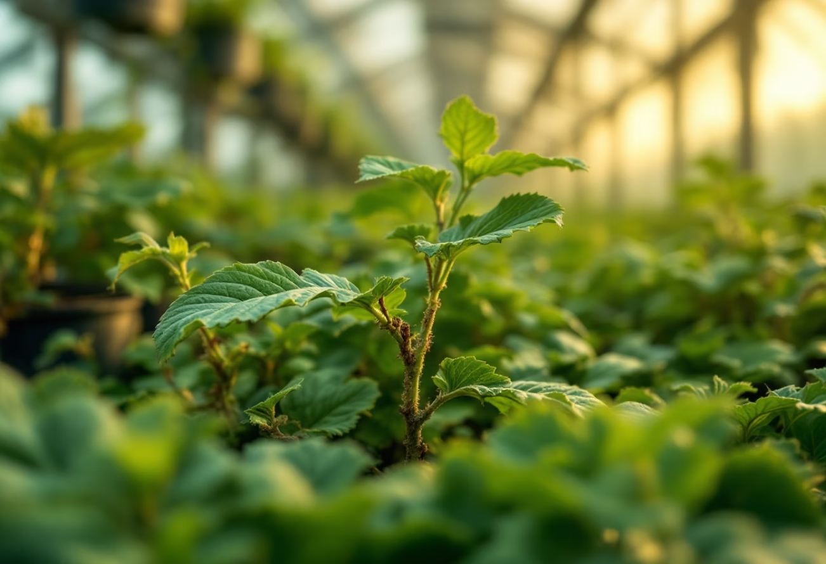

Phase 1: Business Understanding
🚨 Problem Statement: Global Yield Losses
🎯 Project Objectives: Automated & Actionable Insights
Agriculture faces significant challenges, with 20-40% of global crop yields lost annually due to plant diseases. Current manual identification methods are slow, costly, and prone to human error, leading to delayed interventions and further losses.
Our primary goal is to develop an automated system for rapid and accurate plant disease detection using advanced Computer Vision techniques. This system will also provide specific, actionable treatment recommendations to farmers, minimizing losses and improving crop health.
>90%
<50ms
<50MB
Accuracy
Inference
Size
Target accuracy for disease detection.
Desired inference time for real-time diagnosis.
Maximum model size for mobile deployment.

Slide 4
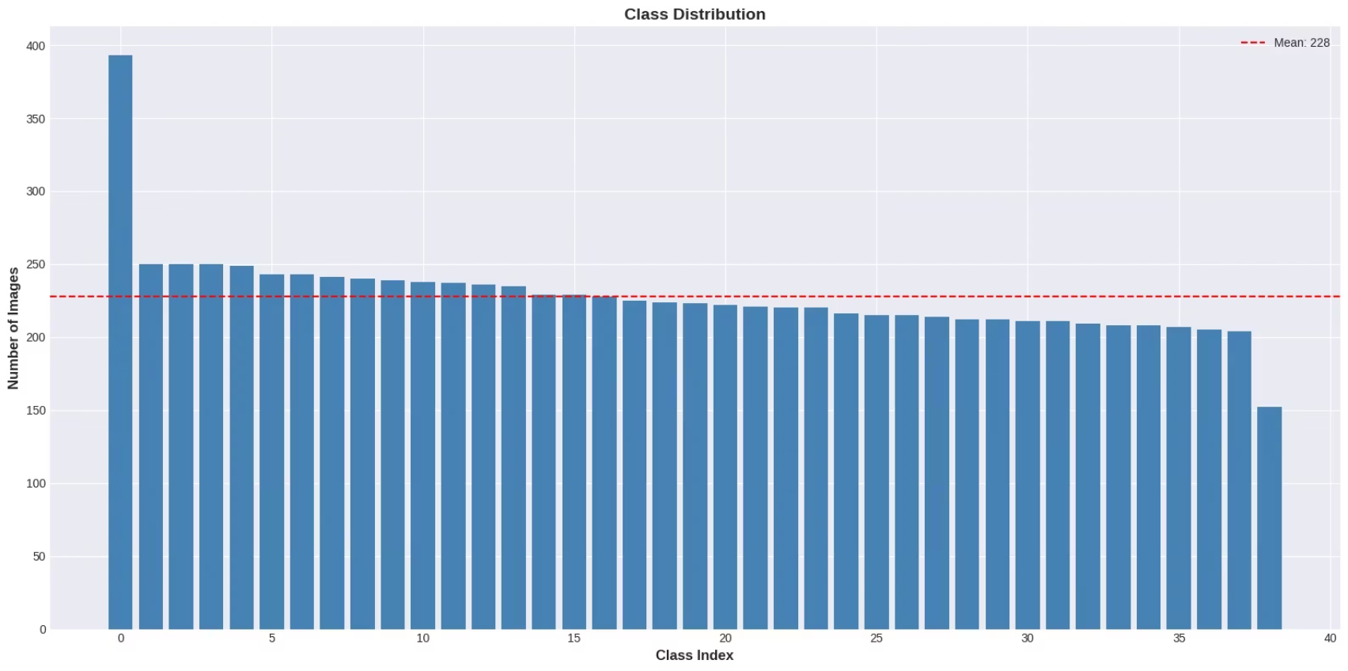
Phase 2: Data Understanding - PlantVillage Dataset
Balance & Distribution
The dataset exhibits a relatively balanced distribution, with a mean of 228 images per class. The class-wise image count ranges from 152 to 395, ensuring adequate representation for most diseases.
Mean: 228 images/class
Range: 152-395 images/class
Challenges & Nuances
Despite its strengths, the dataset presents challenges including potential "lab bias" due to controlled environments and the presence of visually similar diseases that require fine-grained discrimination.
Dataset: PlantVillage
The PlantVillage dataset is a widely used benchmark in plant pathology, comprising 7,600 high-quality images across 38 distinct plant disease classes. This dataset formed the foundation of our training and validation.
Lab bias (controlled conditions)
Similar diseases (e.g., early vs. late blight)

Slide 5
Phase 3: Data Preparation - The Power of Augmentation
Robust data preparation was crucial for building a generalized and accurate model. Our strategy focused heavily on data augmentation to overcome dataset limitations and prevent overfitting.
⚙️ Preprocessing Steps
🎯 Critical Augmentation Techniques
Images were uniformly resized to 224x224 pixels for consistent input.
Rotation: Random rotations up to 30° to simulate various viewing angles.
Pixel values were normalized to a [0, 1] range.
Zoom: Random zooms of up to 20% to account for distance variations.
Dataset split: 85% for training and 15% for validation.
Brightness: Adjustments in the [0.7, 1.3] range for different lighting conditions.
Flips: Both horizontal & vertical flips to increase dataset diversity.
💡 Rationale: Breaking Lab Bias & Preventing Overfitting
The extensive augmentation strategy was designed to force the model to focus on intrinsic disease features rather than extraneous background context or controlled lab settings. This significantly improves the model's ability to generalize to real-world conditions.
Result: This approach led to a substantial +12% accuracy gain, improving performance from 78% to a robust 90.35%.

Slide 6


Phase 4: Modeling Architecture - MobileNetV2 for Efficiency
For our core modeling architecture, we selected MobileNetV2 due to its exceptional balance of performance and computational efficiency, making it ideal for mobile and edge deployment scenarios.
🏆 MobileNetV2
Custom Layers
Leveraged pre-trained weights from ImageNet (frozen layers) for faster convergence and transfer learning. This model's compact size (11 MB) is a significant advantage over larger architectures like VGG (528 MB).
Added custom layers for classification:
GlobalAveragePooling2D: Reduces feature map dimensions.
Dense(128, ReLU): Fully connected layer with ReLU activation.
Dropout(0.3): Regularization to prevent overfitting.
⚙️ Training Configuration
Optimizer: Adam, starting with a Learning Rate (LR) of 0.001, adjusted with ReduceLROnPlateau.
Loss Function: Categorical Crossentropy, suitable for multi-class classification.
Batch Size: 32, optimized for GPU memory and training speed.
Epochs: Trained for 15 epochs, with convergence observed around epoch 14.
Callbacks: Implemented ModelCheckpoint for best model saving, EarlyStopping for optimal convergence, and TensorBoard for visualization.

Slide 7
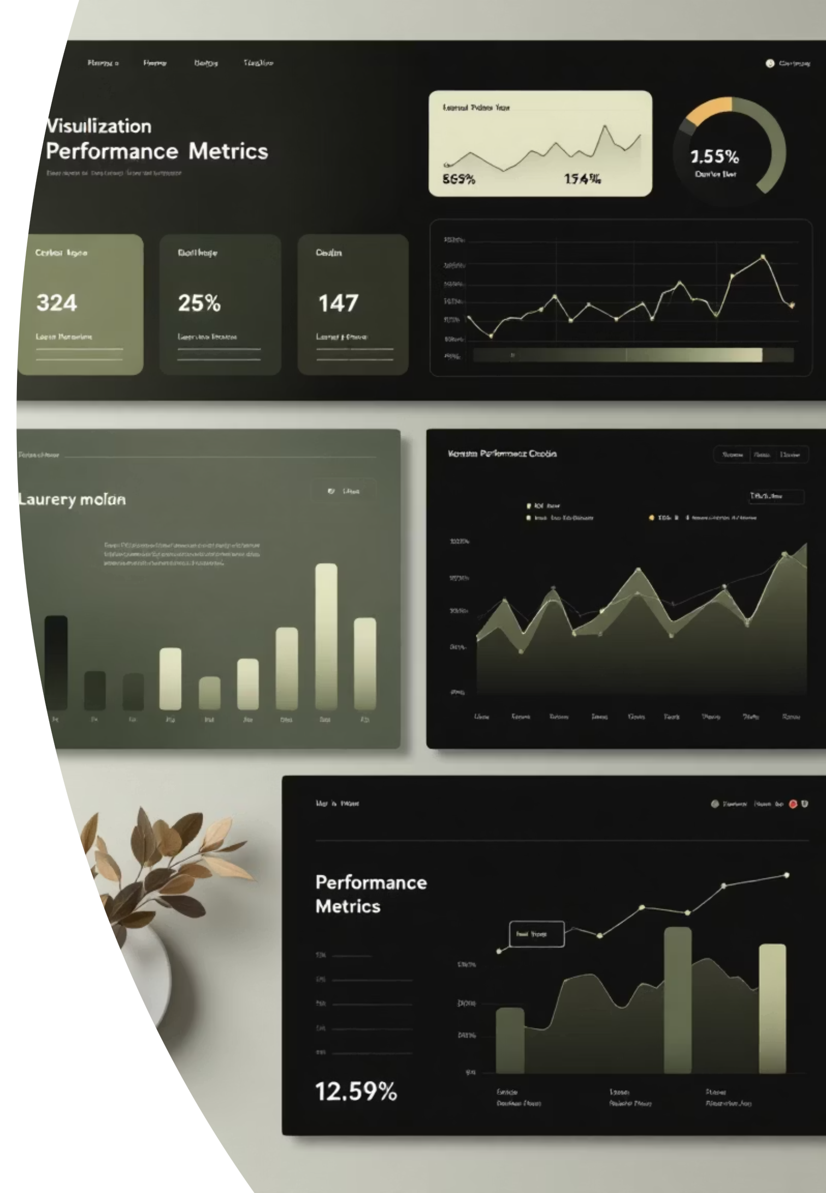




Phase 5: Performance Metrics & Achieved Targets
Our model demonstrated exceptional performance, successfully exceeding the defined project objectives for accuracy, speed, and size.
90.35%
Overall Accuracy
Achieved accuracy, surpassing the >90% target.
89.94%
Precision
High precision indicates a low rate of false positives.
89.51%
Recall
Strong recall signifies the model's ability to identify most true positives.
89.37%
F1-Score
Harmonic mean of precision and recall, reflecting robust performance.
<50ms
11MB
Inference Time
Model Size
Achieved real-time inference, critical for practical applications.
Compact model size, ideal for deployment on mobile devices and edge computing platforms.

Slide 8
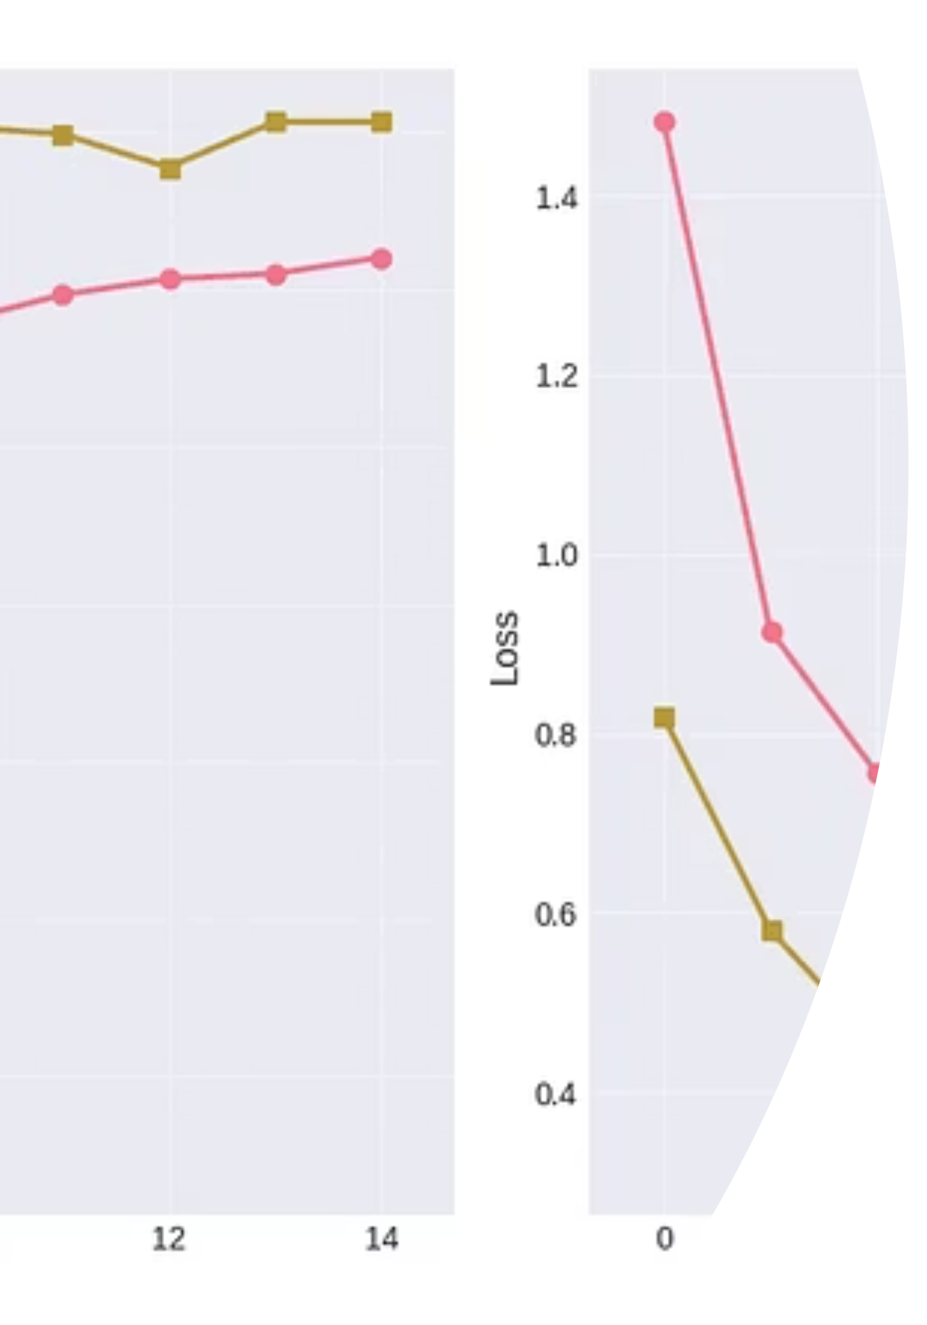
Training Dynamics & Convergence
The training process revealed excellent generalization capabilities and stable convergence, largely attributed to our robust data preparation strategy.
✓ Validation > Training throughout = Excellent Generalization!
The model converged effectively between Epoch 10-14, indicating stable learning.
Consistent performance between training and validation metrics confirmed no overfitting.
The effectiveness of data augmentation was clearly demonstrated by the strong generalization to unseen data.

Slide 9
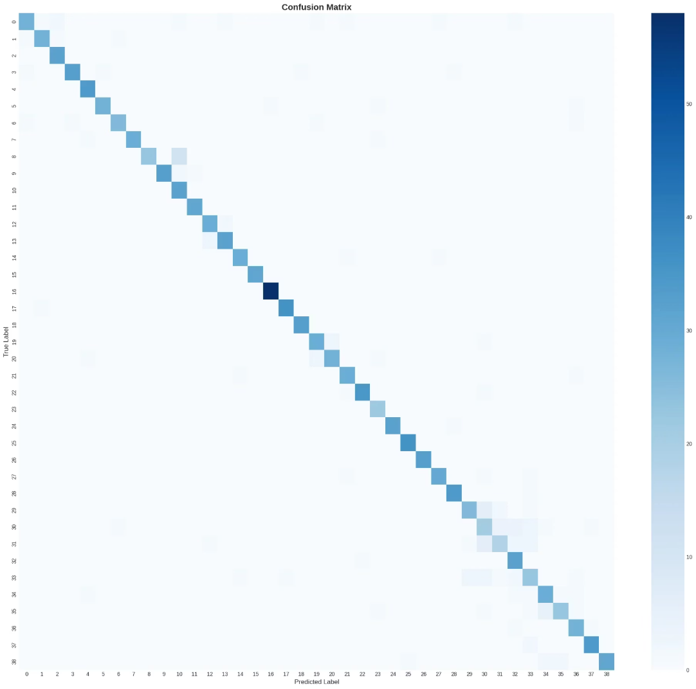
Error Analysis: Unpacking the Confusion Matrix
A detailed analysis of the confusion matrix provides deeper insights into the model's strengths and identifies specific areas for potential improvement.
✓ Strong Diagonal Performance
The prominent diagonal indicates a high number of correct predictions across most classes, demonstrating the model's overall efficacy in distinguishing different plant diseases.
✓ Clear Species Separation
Notably, there was virtually no confusion between different plant species, highlighting the model's ability to correctly identify the host plant before diagnosing the disease.
⚠ Class 16 Confusion: Early vs. Late Blight
The primary area of confusion (approximately 15%) was observed between "Early Blight" and "Late Blight" (Class 16). These diseases often share similar visual symptoms in their early stages, making differentiation challenging even for human experts.
🎯 Near-Perfect Classification Achieved
Despite minor confusion between very similar diseases, the model achieved near-perfect classification for the vast majority of disease classes.

Slide 10
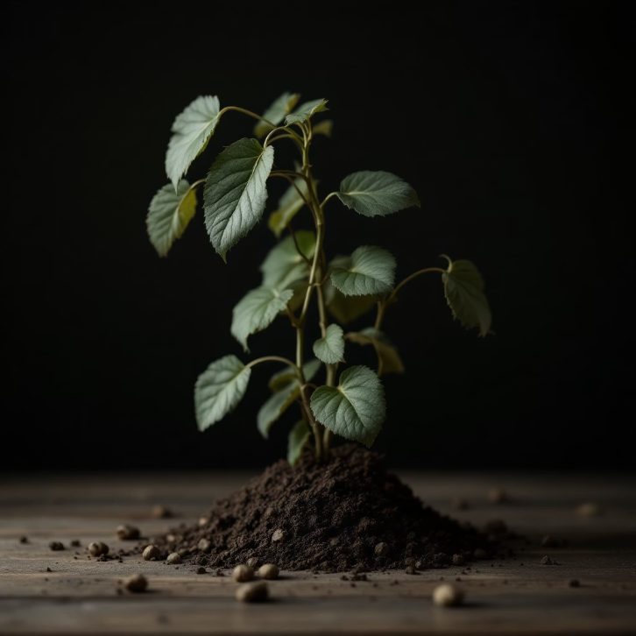

Ablation Study: The Indispensable Impact of Augmentation
Our ablation study clearly demonstrated the critical role of data augmentation in achieving robust model performance and generalization. Without it, the model suffered from severe overfitting.
❌ No Augmentation
VS
✓ With Augmentation
Training the model exclusively on raw, unaugmented images resulted in a significantly lower accuracy and profound overfitting to the training data.
Applying our comprehensive augmentation pipeline transformed the model's performance, leading to a substantial accuracy boost and excellent generalization.
78%
90.35%
Severe Overfitting to Training Data
Excellent Generalization & Robustness
🎯 Augmentation: A +12.35% Accuracy Gain
This study confirms that data augmentation was not merely an enhancement, but a key driver of project success, directly responsible for the significant improvement in accuracy and the model's ability to perform well on real-world, unseen data.

Slide 11




Deployment Architecture: Real-time Plant Disease Detection
Our solution leverages a responsive Gradio web interface powered by a RAG-enabled chatbot using Groq Llama-3-8b, ensuring a seamless user experience from leaf image upload to AI-assisted diagnostics.
Upload
Predict
The user uploads a leaf image through a simple, intuitive interface.
MobileNetV2 instantly classifies the plant disease with high efficiency.
Retrieve
Assist
RAG (Retrieval-Augmented Generation) fetches relevant treatment protocols.
An AI chatbot provides Q&A support for comprehensive guidance.
⚡ Real-time Inference: Sub-50ms response for immediate feedback.
⚠️ Confidence Warnings: Alerts for diagnoses with less than 60% confidence.
🌐 Public URL: 72-hour availability for easy access and testing.
📱 Mobile Ready: An 11 MB model size ensures quick downloads and smooth performance on mobile devices.

Slide 12
Intuitive User Interface & Experience
Designed for ease of use, our interface simplifies the diagnostic process while providing robust feedback and support, ensuring a positive user experience across all devices.
🖱️ Drag & Drop
📊 Confidence Meter
🤖 AI Chatbot
Effortless image uploading with a user-friendly drag-and-drop mechanism.
Immediate visual feedback on prediction accuracy helps users assess reliability.
Integrated for interactive Q&A, providing detailed treatment information and advice.
⚠️ Safety Guardrails
📱 Mobile Responsive
Proactive alerts for low-confidence diagnoses, guiding users to seek expert help when necessary.
Optimized for all screen sizes, guaranteeing accessibility and functionality on any device.

Slide 13
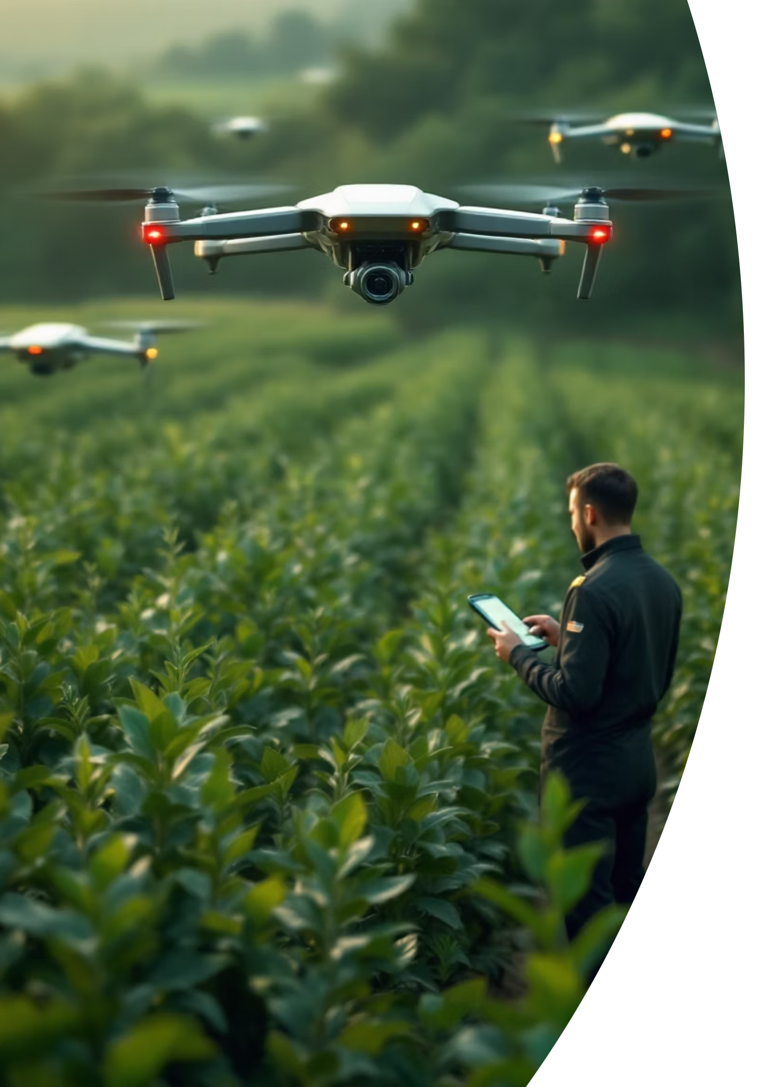



Conclusion & Future Work
Our project successfully demonstrates the power of AI in agricultural tech, with promising avenues for further development and expansion.
Achievements
Lessons Learned
CRISP-DM methodology applied for structured development.
Data augmentation increased accuracy by +12%.
Achieved 90.35% diagnostic accuracy.
Validated effectiveness of transfer learning techniques.
Developed an 11MB lightweight model for efficiency.
Emphasized the critical importance of validation over training accuracy.
Seamless GenAI integration for enhanced capabilities.
Future Directions
Develop a dedicated mobile app using TFLite for offline Android/iOS functionality.
Integrate Edge AI with Raspberry Pi for drone-based field monitoring.
Expand the dataset with real-world field images for greater robustness.

Slide 14





Team Contributions & Acknowledgments
This project was a collaborative effort, combining diverse expertise to achieve our goals. We extend our gratitude to the platforms and tools that made this possible.
Pratham Rajesh
Shreram Palanisamy
Resources & Tools
Our project leveraged the PlantVillage dataset for training, with TensorFlow, Gradio, and Groq forming our core framework. Development was primarily conducted on Google Colab using T4 GPUs.

Slide 15
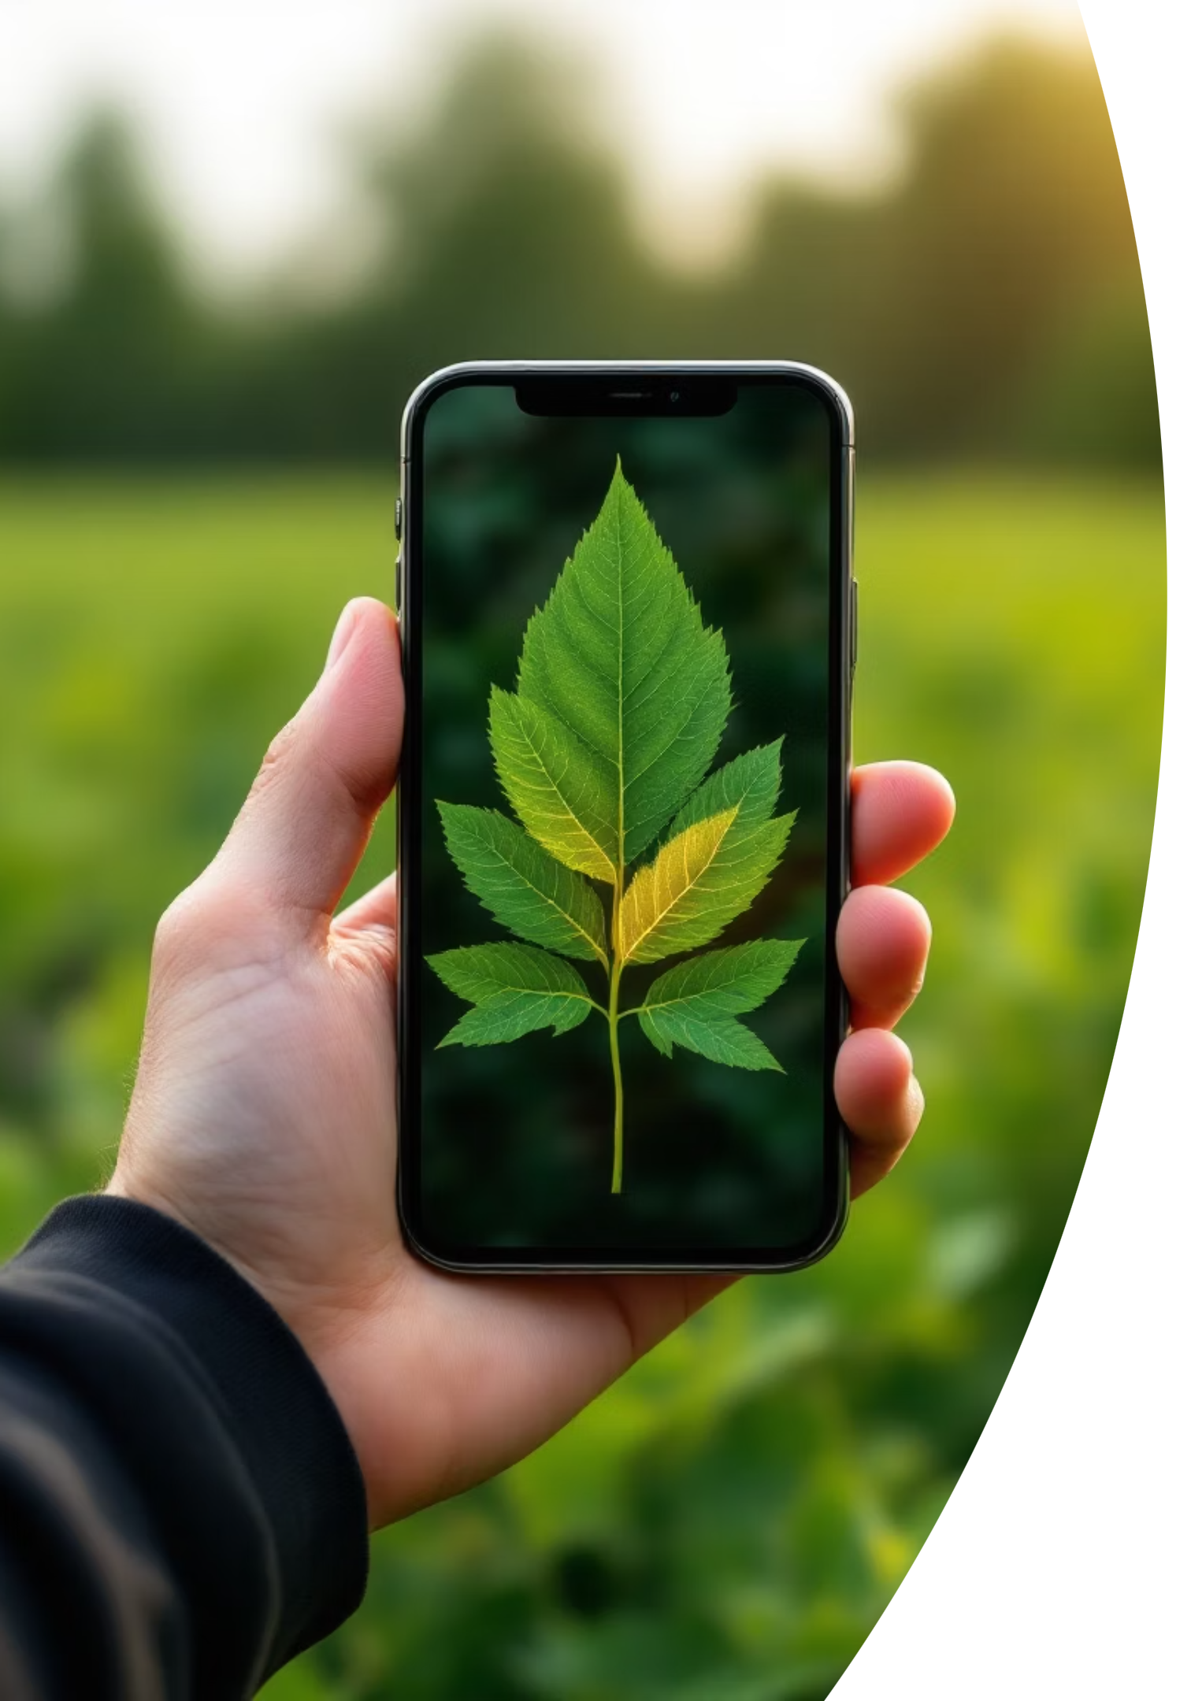
LIVE DEMO
🌿 Plant Disease Detection
Experience real-time AI-powered diagnosis in action

